Slide 1
Review of Computer Organization
Haojin Zhu
Professor

Slide 2
Chapter I: Performance Evaluation
Throughput
Response Time
CPI=clock cycles per instruction
Clock cycle
Instruction Count
Transition from uniprocessor to multi-core (why?)
Amdahl’s law (what is the limit for performance improvement?)
MIPS=million instructions per second

Slide 3
Chapter II: Instructions: Language of Computer
MIPS (RISC) Design Principles
Simplicity favors regularity
Smaller is faster
Make the common case fast
Good design demands good compromises
Three kinds of instructions: R type, I type, J type (format)
Handling large constant: lui+ori
Branch destination
Jump destination
Programming is not required in the final

Slide 4
Chapter 3: Arithmetic for Computers
2’s complement, 1’s complement, biased notation
Zero extension vs sign extension
Overflow
Basic multiplication and advanced multiplication algorithm
Restoring division/ non-restoring division (comparision?)
IEEE 754 floating point: single precision, double precision
Representation range and accuracy
Addition and multiplication
Round (e.g., round to nearest even)

Slide 5
Chapter 4A: The Single Cycle Processor
Clocking methodology
How to design the processor step by step
Data path for R-type, I-type, LW, SW, branch, jump
Critical path= Longest Delay Path (assignments)
Control Signals for different instructions

Slide 6
Chapter 4B: Multi-cycle Datapath
Why need multi-cycle datapath?
Datapath and control signals for different instructions in different stages?
Average CPI
Compare the performance of single cycle and multi-cycle datapath

Slide 7
Chapter 4C&D: Pipeline and Data Hazard
Data path in pipelined processor and control signals (see the assignment)
Data Hazard: RAW, WAW, WAR
Handle RAW data hazard
Stall the pipeline: Insert Noop
Forwarding: conditions (special case: load use data hazard)
Handle WAW and WAR
Renaming
Handle Branch
Prediction
Flush (difference between noop and flush?)
Scheduling (Not required in the final)
Exception
Interrupt
Trap

Slide 8
Chapter 4E: Multiple-Issue Processor
The techniques for modern processor (understanding the concept is ok)
deeper pipelines: superpipelining
Multi-issue processor: Superscalar
Reduced CPIstall
Diversified pipeline
Out of order execution
Branch prediction
Identify and resolve stalls of RAW, WAW, WAR
Code scheduling (NOT required in this final)

Slide 9
Problem Distribution of the final exam
1. Performance evaluation (20’)
2. Multiplication, division and floating point (20’)
3. Single cycle datapath (10’)
4. Multiple cycle datapath (10’)
5. Pipleline and Data dependence (20’)
7. Brief answer (20’)
Your final score= Final exam + Added Score

Slide 10
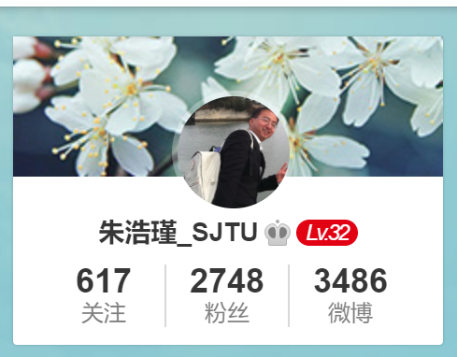
Other reminder for final examination
Please pay special attention to examples in slides+ assignments (especially those examples I presented in classes) + text book (at least 1 time)
Time & Location
2016-12-27 第16周星期三 18:00－20:00 中院112（二专）
You could bring dictionary, calculator. Other course material is not allowed
Contact me by @ 朱浩瑾_SJTU in sina weibo

Slide 11
Best Wishes for you in the finals

